Slide 1
Give great customer service with Microsoft Dynamics CRM
Get started with common support tasks

Slide 2
keep track of your customer requests
Keep track of your customer requests and issues by creating support cases in Microsoft Dynamics CRM.
When a customer contacts support with a question or problem, you can quickly check to see if there is an existing case or open a new case and start tracking the issue.
Applies to: CRM Online Spring '14 or CRM 2013 Service Pack 1 or later (on-premises)

Slide 3
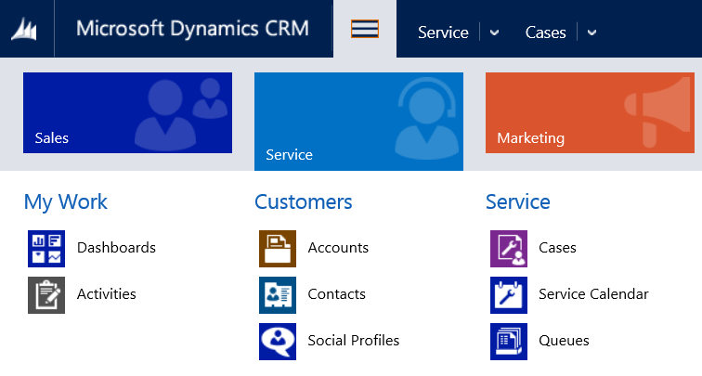
get started
If your screen looks like this (latest version):
On the nav bar, choose Service > Cases. Choose New Case.
If your screen looks like this (older versions):
Choose Microsoft Dynamics CRM > Service > Cases. Choose New Case.

Slide 4
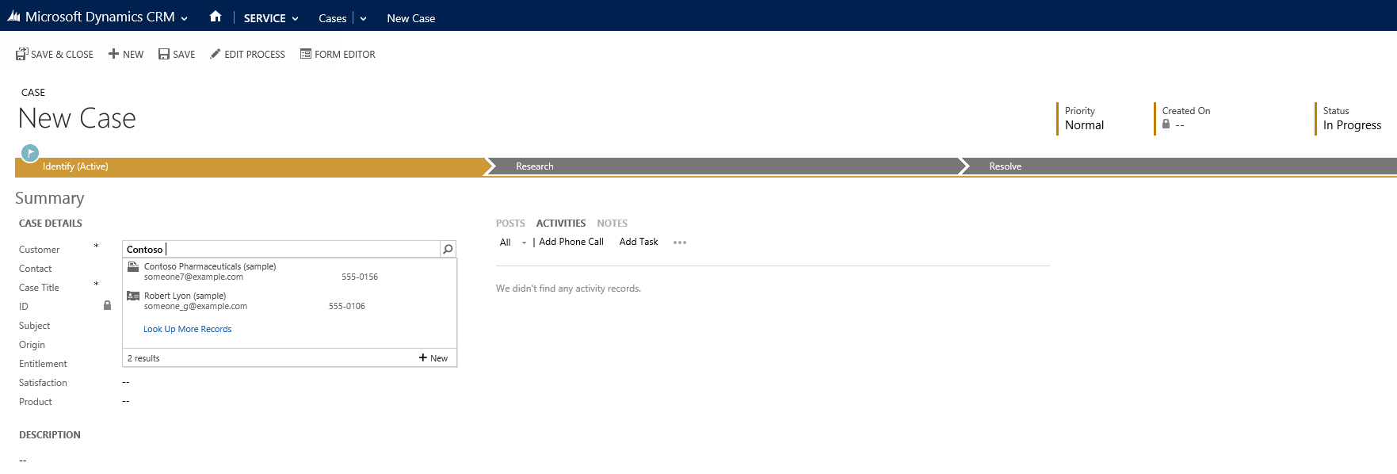
check for duplicates cases
Before you create a new customer record, check to see if it is already in the system.
1
2
Choose the Customer lookup button.
If a record for the customer does not exist, choose New to create a new contact record.

Slide 5
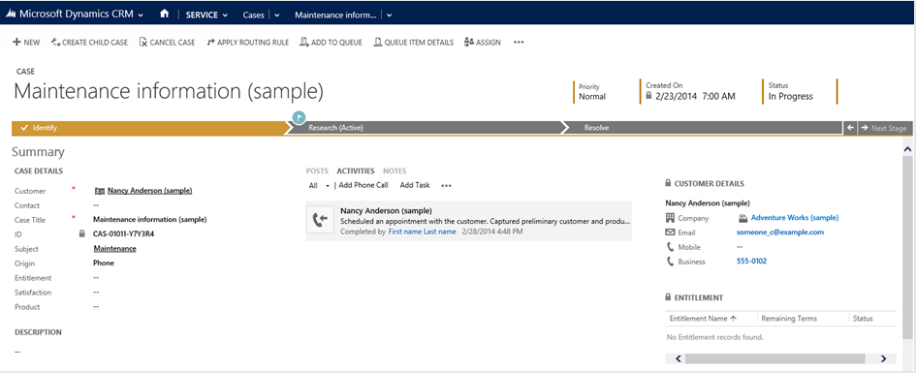
…continued
To help resolve a case, each stage and step is clearly outlined in the process bar at the top of the screen. You’ll see the process bar when you move from one stage to the next when you’re working on a case.
2
1
1. Choose a field to enter data as you handle the details.
2. Choose the process bar to see the steps in a stage.

Slide 6
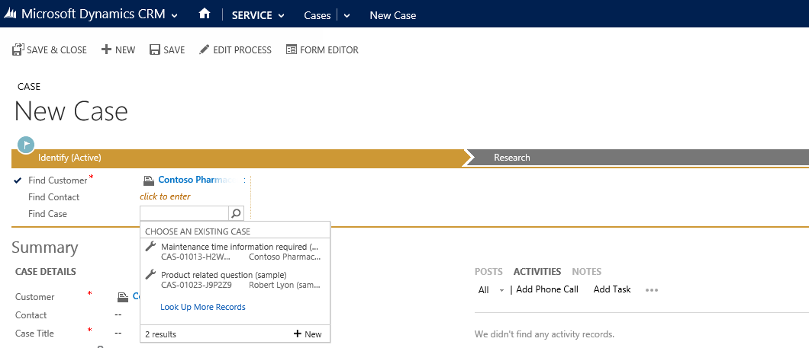
…continued
When you select an existing customer, the customer details will show the contact details, along with recent cases and activities for the customer.
1. Choose the Identify stage on the process bar.
1
2. Choose the Look up button and select an existing case.
Or, if it’s a new case, choose New.
2

Slide 7
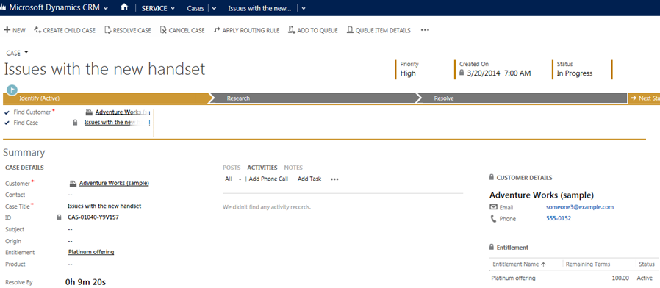
provide the right level of support
Use entitlements to see what kind of support you should provide the customer.
If the entitlement is not applied automatically, choose the Entitlements Look up button and then select an entitlement.
This is where you’ll see a customer’s entitlements for support.
Applies to: This feature is only available in organizations that have applied product updates for CRM Online Spring '14 or CRM 2013 Service Pack 1

Slide 8
track your communication history
Choose Activities > Add Phone Call or choose NOTES to add your case activities and notes.

Slide 9
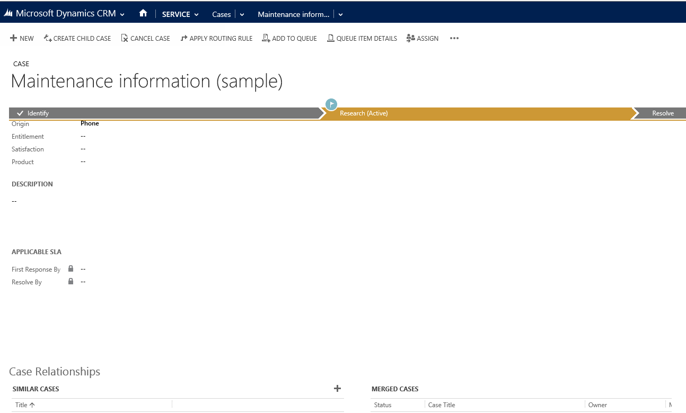
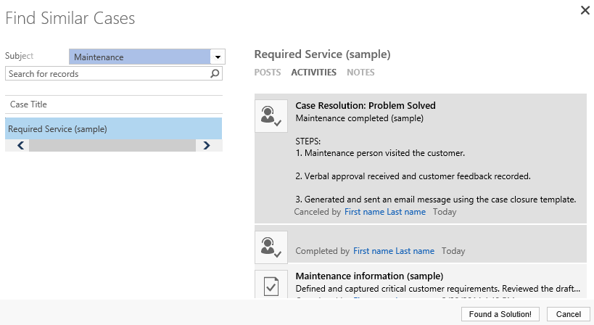
look up solutions from other cases
Look at similar cases to help you resolve the case you’re working on.
Tip: By default, the search will look for cases with a similar subject.
3
1
2
4
Choose Case Relationships.
Choose (+) Add Connection record.
From the Find Similar Cases dialog box, use the search to find similar cases.
Once you find the case that has the information you need to resolve the case you’re working on, choose the case, and then choose Found a Solution.

Slide 10
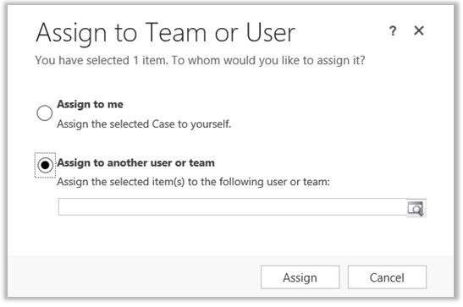
reassign a case to someone else
If you don’t have enough information to resolve a case, or if you think another member in your team has expertise on the subject, you can reassign the case to them.
1
2
3

Slide 11
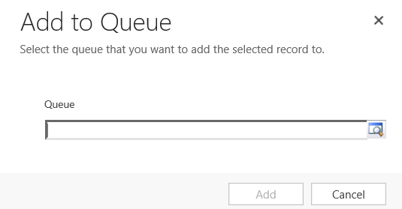
put a case back in to the queue
If you don’t know who to assign the case to, you can move the case to a queue and have someone else pick it up.
1
2

Slide 12
or, automatically route a case to a queue
You can also route the case to another queue based on the active routing rule your service manager has turned on.
Applies to: This feature is only available in organizations that have applied product updates for CRM Online Spring '14 or CRM 2013 Service Pack 1

Slide 13
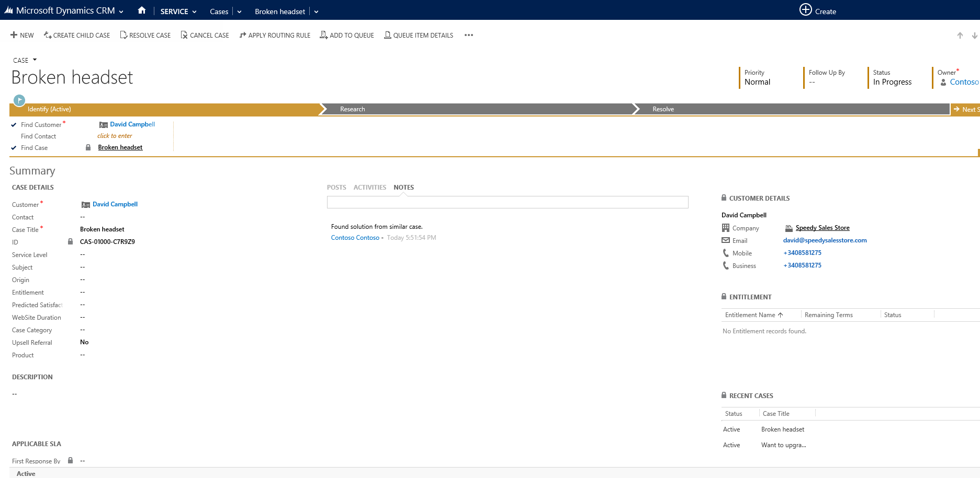
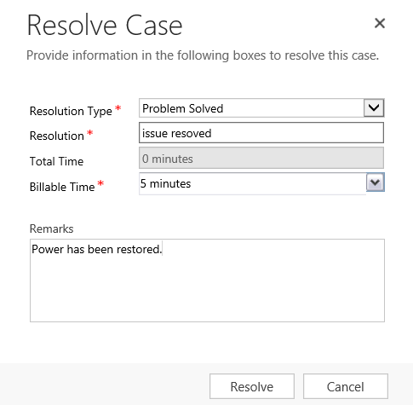
close a case
1
Select and fill in the appropriate information.
2
3

Slide 14
merge similar cases
Eliminate redundancies between similar cases by merging them into one case. When a customer opens multiple cases about the same issue (through different support channels) or when multiple customers from the same account call in about the same issue, you can merge those cases into one case.
If your screen looks like this (latest version):
On the nav bar, choose Service > Cases. Choose New Case.
If your screen looks like this (older versions):
Choose Microsoft Dynamics CRM > Service > Cases. Choose New Case.
Applies to: This feature is only available in organizations that have applied product updates for CRM Online Spring '14 or CRM 2013 Service Pack 1

Slide 15
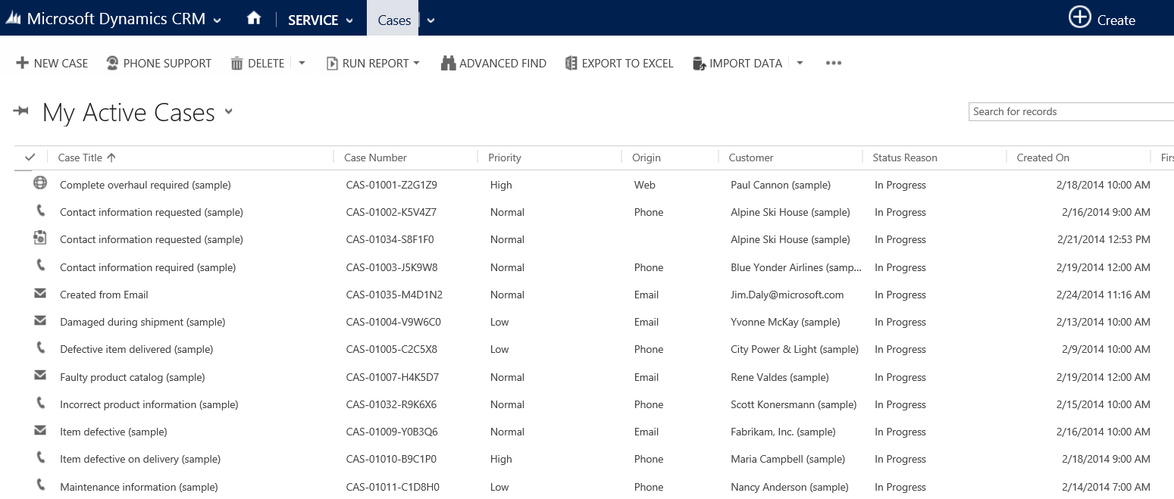
….continued
On the next screen, you will see a list of your active cases.
Applies to: This feature is only available in organizations that have applied product updates for CRM Online Spring '14 or CRM 2013 Service Pack 1

Slide 16
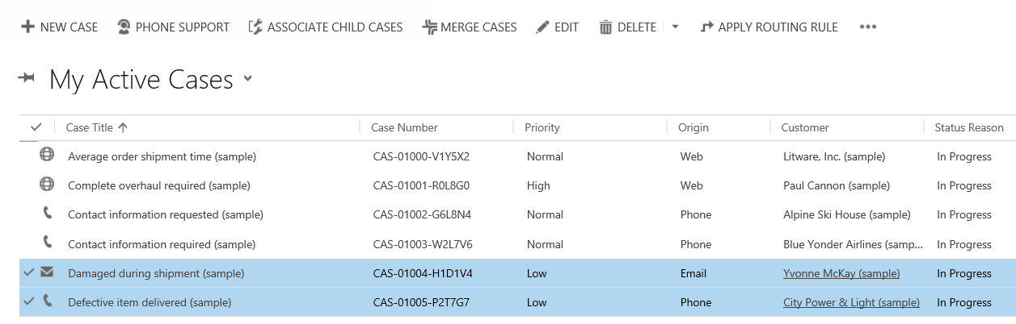
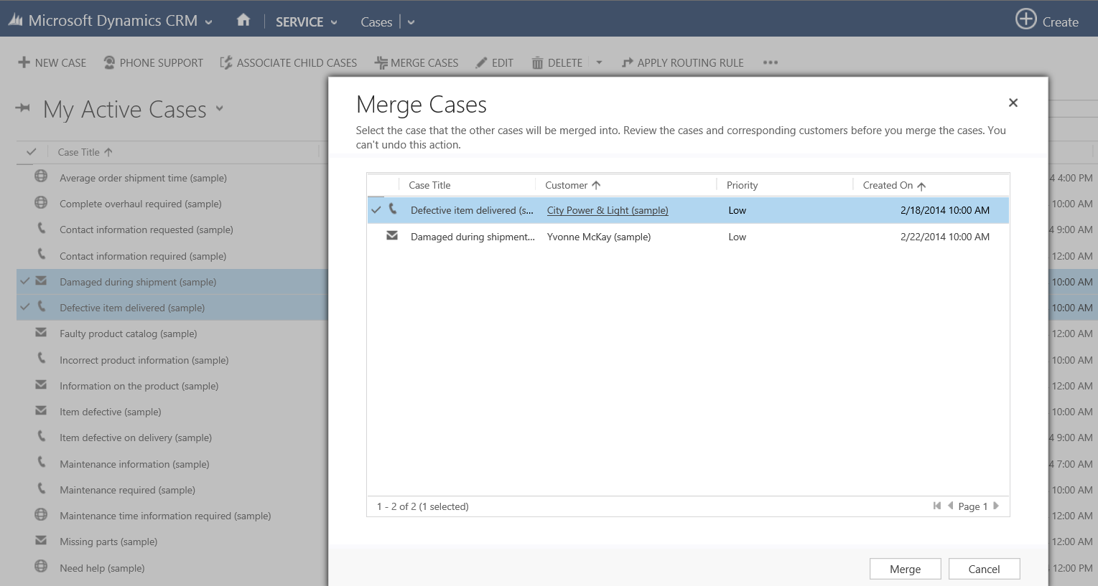
…continued
When a case is merged, the state of the case is changed to cancelled and the status is changed to merged. That’s because it’s merged into another case and all of the open case activities, emails, and attachments are now associated with the case it was merged into.
1. Select the cases that you want to merge.
2
2. Choose Merge Cases.
3. Select the case that the other cases will be merged into..
1
4. Choose Merge.
3
4
Applies to: This feature is only available in organizations that have applied product updates for CRM Online Spring '14 or CRM 2013 Service Pack 1

Slide 17
track issues efficiently
When there is a case where work needs to be done by multiple teams or when one issue effects multiple customers, now a customer service rep can open a primary case, called the parent case, and then create a secondary case, called the child case.
Here is one issue from the same customer that needs work done on it by other teams.
Here the same issue is affecting multiple customers from the same organization.
Building construction (parent case)
Electric fittings (child case)
Bathroom fittings
(child case)
Flooring
(child case)
Network Outage
(parent case)
Customer 1
outage
(child case)
Customer 3
No network
(child case)
Customer 2
outage
(child case)
Applies to: This feature is only available in organizations that have applied product updates for CRM Online Spring '14 or CRM 2013 Service Pack 1

Slide 18
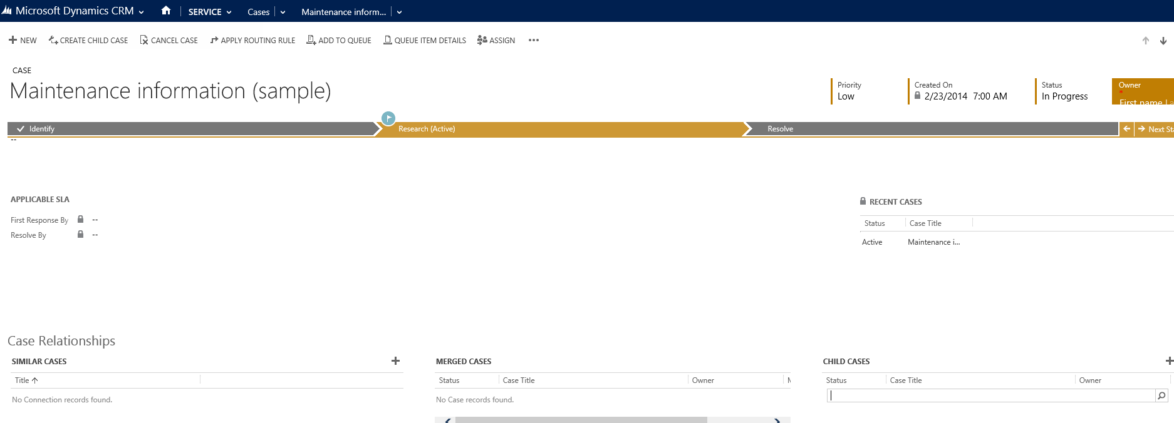
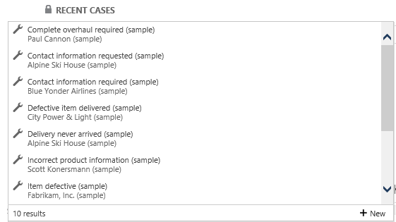
add a child case
Create a new child case or link an existing child case from the case form.
1
2
1. Choose Create Child Cases.
2. Search for an existing case and add it as a case child. Or, choose New to create a new child case.
IMPORTANT : The child case option isn’t available for child cases of other cases. However, if child cases are deleted from other parent cases, then the child case option is available.
Applies to: This feature is only available in organizations that have applied product updates for CRM Online Spring '14 or CRM 2013 Service Pack 1

Slide 19
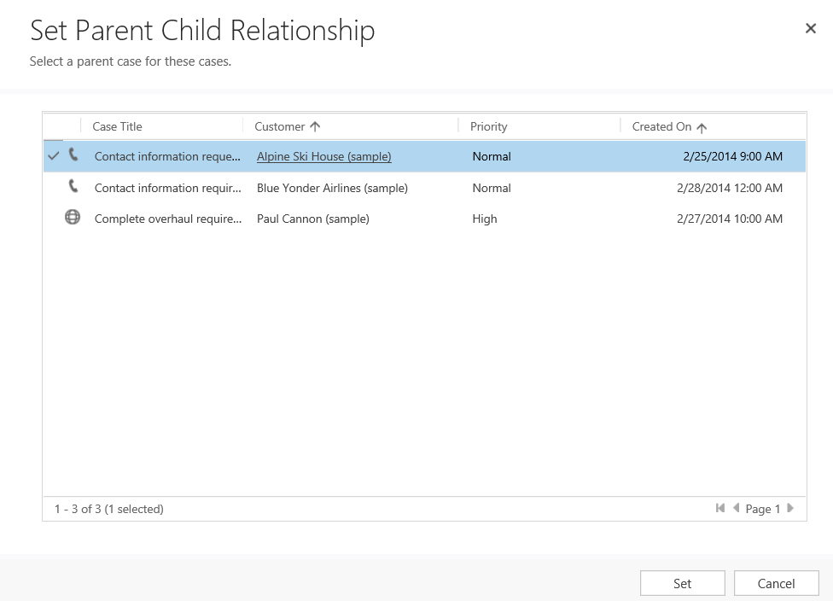
…continued
You can also associate an existing case as a child case from your active list of cases.
2
1
3
Select the cases that you want associate.
Choose Associate Child Cases.
Select a parent case for the child cases.
Choose Set.
4
Applies to: This feature is only available in organizations that have applied product updates for CRM Online Spring '14 or CRM 2013 Service Pack 1

Slide 20
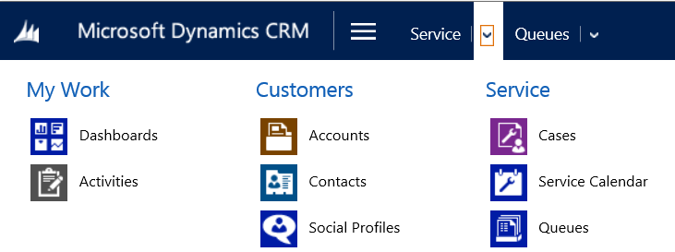
look for open cases that need to be worked on
Use queues to quickly see cases assigned to you or cases that are available to work on.
If your screen looks like this (latest version):
On the nav bar, choose Service > Queues. Choose New Case.
If your screen looks like this (older versions):
Choose Microsoft Dynamics CRM > Service > Queues.

Slide 21
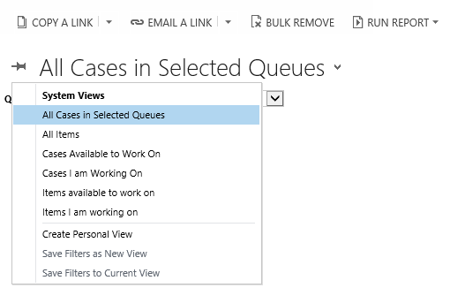
…continued
Select a view.

Slide 22
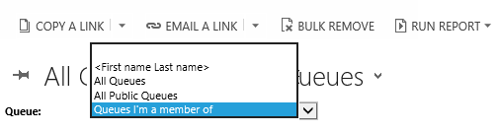
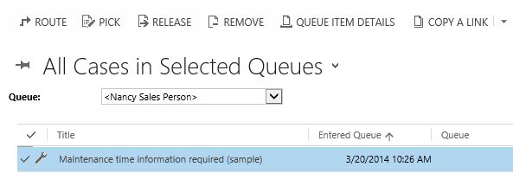
…continued
1. Select a queue.
2. Select the case or item that you want to work on.
3. On the command bar, choose Pick.
1
3
2

Slide 23
Thanks for reading!
Did this eBook help you? Send us a quick note. We’d love to know what you think.
Help & Training Site
Version 7.1

