Slide 1
Business processes in Dynamics CRM
[Insert image here]
Follow consistent steps every time you work with your customers.

Slide 2
handle all the important details
Business processes help you work with your customers consistently by guiding you through standard stages and steps for common tasks.
For example, your organization may want everyone to handle new sales leads or service cases the same way. Business processes help you do that.
[Insert image here]
TIP:
Several ready-to-use processes for common business scenarios are available. Find out how to add them to your system.
Applies to: Microsoft Dynamics CRM Online & Microsoft Dynamics CRM 2015

Slide 3
check out the process bar
To help you work with customers, each stage and step is clearly outlined in the process bar at the top of the screen. You’ll see the process bar when you work on certain types of customer records, like leads or opportunities.
Choose a field to type in the details.
Choose a stage in the process bar to see the steps involved.

Slide 4
look at an example
The best way to learn about how business processes help you work with customers is to look at an example.
Let’s look at a standard business process for working with leads.
[Insert image here]

Slide 5
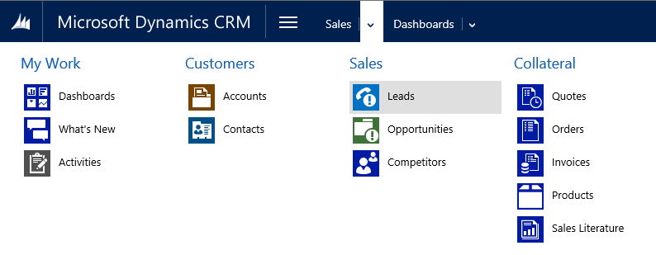
first, go to your leads
If your screen looks like this (latest version):
Go to Sales > Leads.
If your screen looks like this (older version):
Go to Microsoft Dynamics CRM > Sales > Leads.

Slide 6
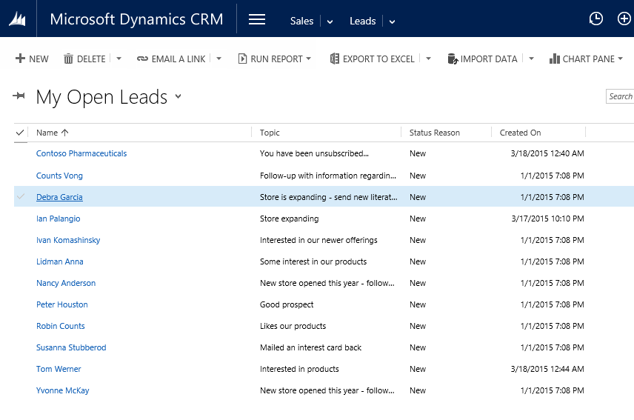
…and then select an existing lead

Slide 7
check out the business process for leads
When you work with a lead, the process bar shows you all the steps you need to follow to complete each stage successfully. It’s your roadmap to getting things done.
A lock means this stage moves the lead to another record type, such as an opportunity.
A flag shows the current stage.
A check mark means the step is complete.

Slide 8
enter data to complete each step
You can edit fields directly on the process bar.
Choose a field within a step to type in details.
Steps automatically receive a check mark when you complete them.

Slide 9
visualize your progress
As you complete the steps, each stage provides guidance about what to do next, and helps you see your progress.
Choose a stage to preview the steps in it.
Choose Next Stage to advance through the process.

Slide 10
advance through the stages
When you’ve completed all the steps, you’ll need to advance to the next stage. You can move to another record type – for example, a lead can become an opportunity as you nurture a deal.
List of available records
1
Click or tap Next Stage, and then select the next record type.

Slide 11
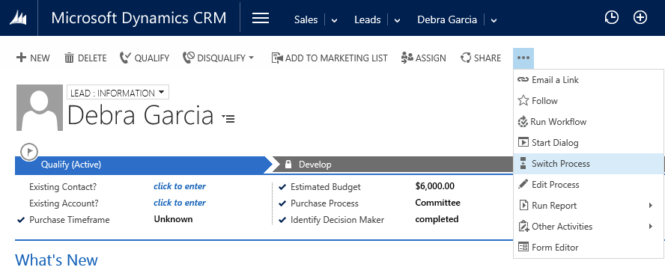
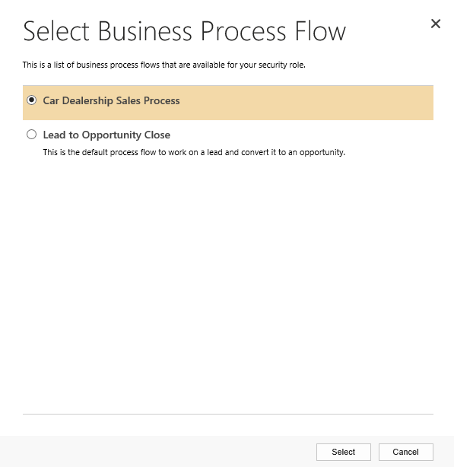
switch to another business process
Discover mid-stream that you need to follow a different process for a customer? No problem.
Choose … , and then choose Switch Process.
Select a different process.
Choose Select.

Slide 12
Thanks for reading!
Did this eBook help you?
Send us a quick note.
We’d love to know what you think.
CRM Help & Training site
Version 7.1.1

