Slide 1
www.dtrofimczuk.co.uk
KOODIKERHO
Darren Trofimczuk & Johanna Santanen
4th December 2015
Tervetuloa!

Slide 2
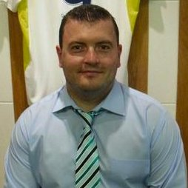
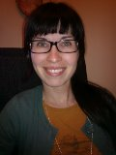
What is Koodikerho?
ENGLISH
LOGICAL THINKING
BASIC PROGRAMMING
Darren Trofimczuk-
Lecturer Haaga-Helia, Owner TrofTech
GAME DESIGN
TESTING
PLANNING
EVALUATING
Johanna Santanen-
Joint Owner Carespace.Fi

Slide 3
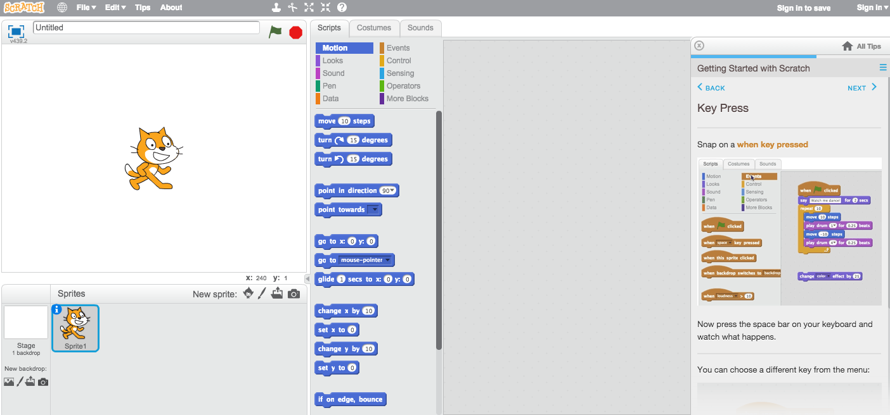
Scratch
We use Scratch software for our learning

Slide 4
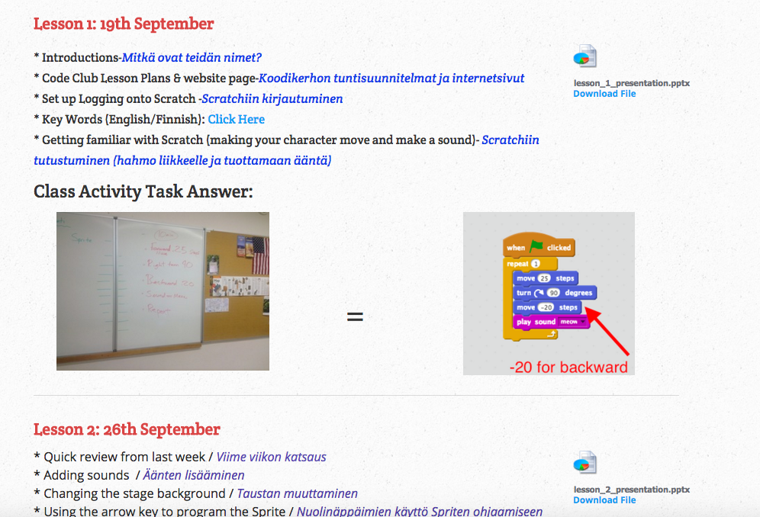
Darren Trofimczuk’s Website
Step by Step instructions each week
www.dtrofimczuk.co.uk/computer-club.html

Slide 5
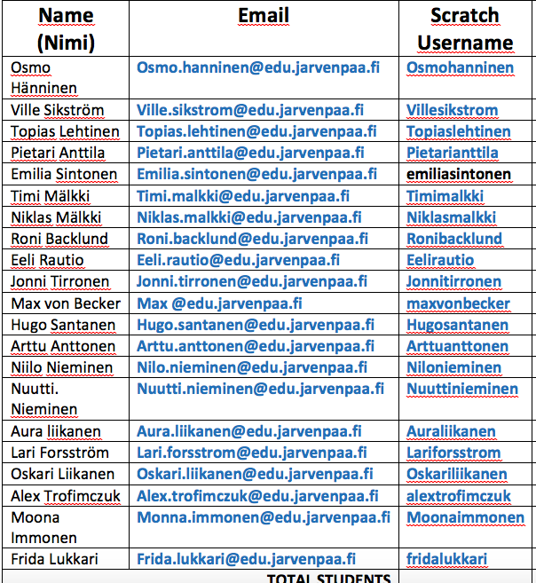
Student Online Scratch Accounts
Each student uses their own online Scratch account

Slide 6
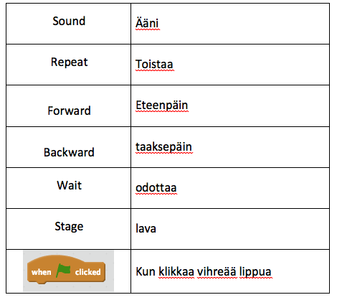
English & Finnish Words

Slide 7
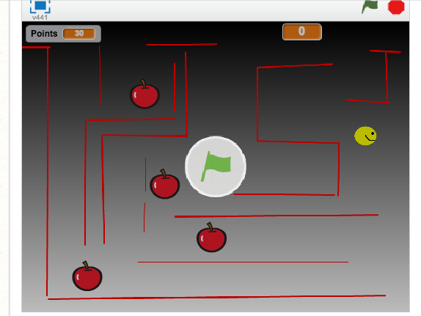
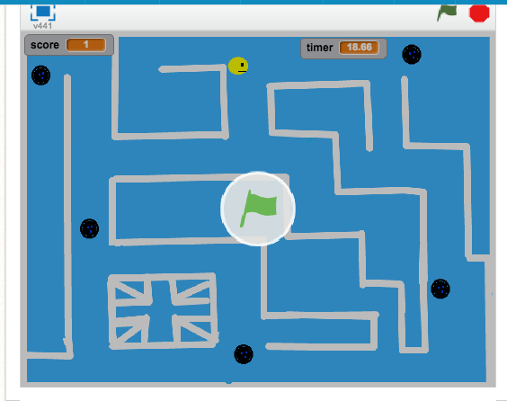
Final Day
Each student has created their own game using Scratch. Please walk around the class and take a look at their designs
Jokainen opiskelija on luonut omalla peli Scratch . Ole hyvä kävelläluokan ja katsomaan Niiden mallit

